Slide 1
SECURE DATA HIDING IN IMAGES USING STEGANOGRAPHY
SECURE THE DATA TO PREVENT HACKER PROJECT
Presented By: Guruvelli Divya
Student Name : Guruvelli Divya
College Name : DR B.R Ambedkar University Department :Computer Science and Engineering

Slide 2
OUTLINE
Problem Statement
Technology used
Wow factor
End users
Result
Conclusion
Git-hub Link
Future scope

Slide 3
Problem Statement
The project focuses on developing a steganographic system for securely embedding and retrieving hidden data in images. The system should:
Hide confidential information within an image without noticeable distortion.
Extract the hidden data accurately without loss.
Ensure security against unauthorized detection and modification.

Slide 4
Technology used
1.Programming Languages
Python – For implementing the steganography algorithm and GUI.
2.Image Processing Libraries
OpenCV2– For image handling and processing.
3. Steganography Techniques
Least Significant Bit (LSB) Substitution -Embeds data in the least significant bits of image pixels.
Discrete Cosine Transform (DCT) Steganography – Hides data in frequency components of an image.
Pixel Value Differencing (PVD) – Uses variations in pixel intensities to hide data.

Slide 5
Wow factors
1️⃣ Live Demonstration 🎥
Show a real-time demo of hiding and extracting a secret message in an image using Python
(OpenCV or Steganography tools).
This will make your presentation interactive and engaging.
2️⃣ Before & After Image Comparison 🖼️
Display two images: one original and one with hidden data.
Ask the audience: "Can you spot the difference?"
This will visually demonstrate how steganography works.
3️⃣ Real-World Applications & Security Risks 🔐
Explain how governments, cybersecurity teams, and hackers use steganography.
Discuss ethical concerns & detection techniques to raise awareness.

Slide 6
End users
1️⃣ Cybersecurity & Intelligence Agencies 🔐
Used for covert communication in intelligence operations.
Helps in secure transmission of sensitive data over public networks.
Used in anti-cybercrime operations to track malicious activities.
2️⃣ Journalists & Activists 📰✊
Protects whistleblowers and activists from surveillance.
Enables secure sharing of confidential reports without detection.
Helps bypass censorship in restrictive regimes.
3️⃣ Military & Defense Organizations ⚔️
Used for secure communication in war zones.
Prevents data interception by enemy forces.
Ensures national security and confidential mission strategies remain hidden.

Slide 7
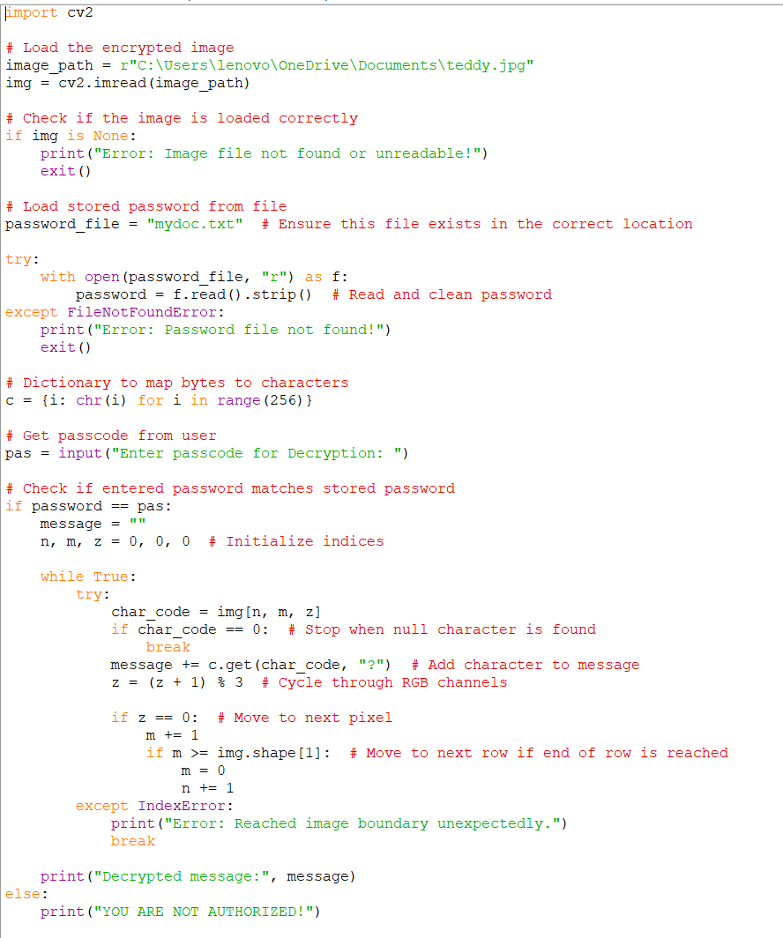
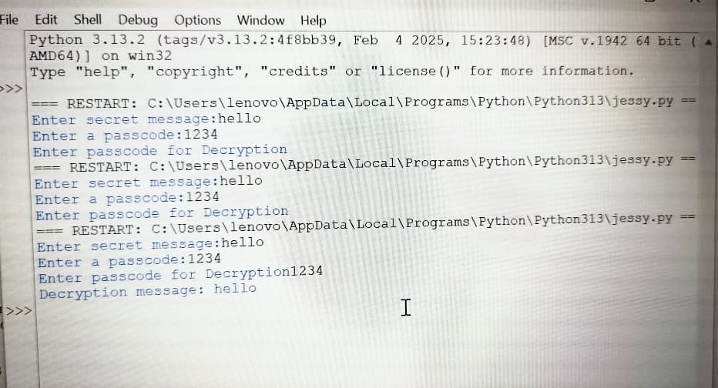

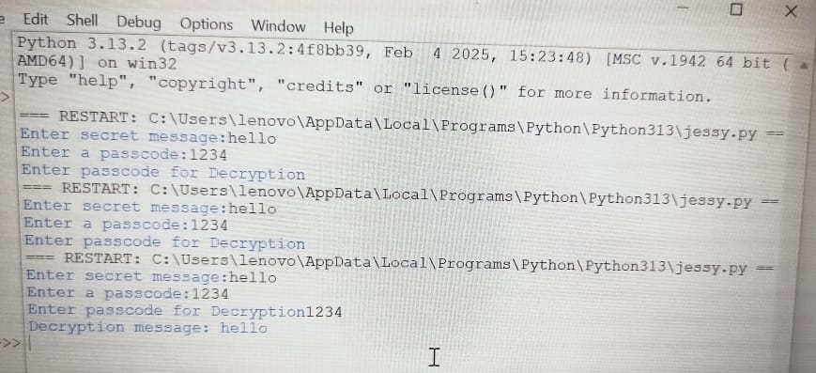
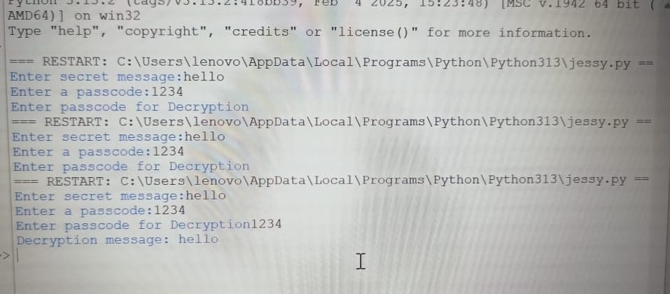
Results

Slide 8
Conclusion
Secure data hiding in images using steganography is a powerful technique for concealing sensitive information in digital media. It ensures confidentiality, integrity, and security of data transmission without attracting attention.
🔹 Key Takeaways: ✅ Provides covert communication in intelligence and cybersecurity. ✅ Protects journalists, activists, and businesses from surveillance and cyber threats. ✅ Used in military, forensic investigations, and digital watermarking for security.
As cyber threats evolve, steganography continues to be a vital tool in secure communication and digital forensics, ensuring privacy and security in the digital age. 🔏💡

Slide 9
GitHub Link
https://github.com/GDivya2004/My_Project_AICTE.git

Slide 10
THANK YOU

